Slide 1



Data Visualizations and Dashboard with Tableau
Milan Verma

Slide 2
Project
In this project, we will be exploring the trends and patterns through various visualizations of Fifa18 Dataset which contains more than 17k players with 70 different attributes.
We will be focusing on effective attributes that help us visualize the data better

Slide 3
World Map
It shows the world map of all the countries that were part of Fifa 18, with numbers on countries telling count of players
Dark Blue countries has higher overall ratings and Dark Orange has lower overall ratings

Slide 4
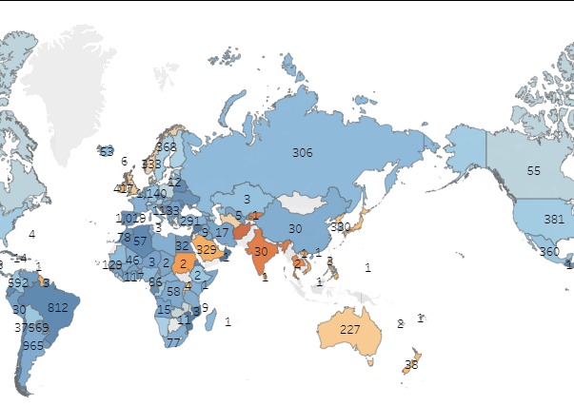

Slide 5
Average ratings and number of players
Firstly, here are the top countries with Average overall ratings
However, this data contains countries with only 1 player
Secondly, the same chart but here countries has more than 100 players.
Here, the Average is 66 and most of the countries are around this line.

Slide 6
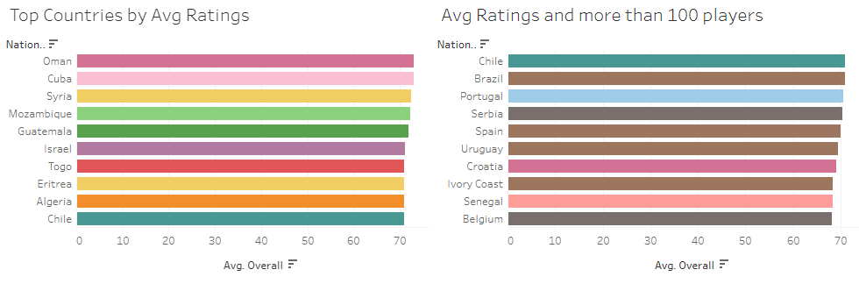

Slide 7
Tree Map of Market Value
Here is the treemap of Total Market Value by Countries
Here 8 out of top 10 countries are European

Slide 8
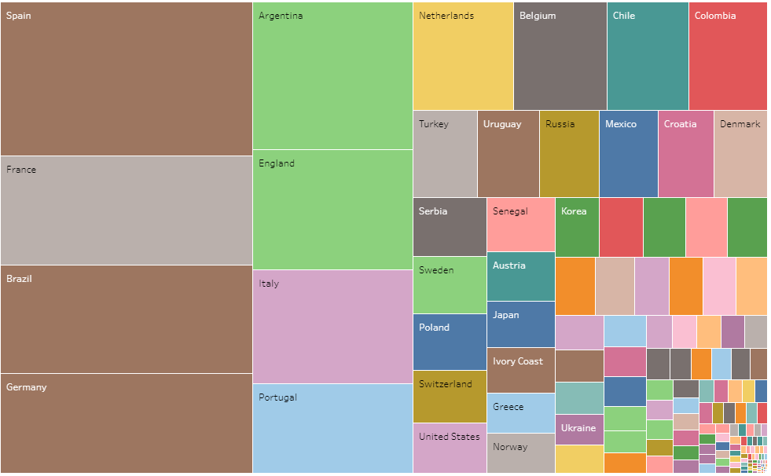

Slide 9
Scatter Plot
Here data is divided in 7 clusters
And size of the circle represents the average value of the player
7th cluster consists of players like Cristiano Ronaldo, Neymar, Messi, Suarez, Lewandowski, Hazard, and K. De Bruyne
Interestingly these players also has higher overall and potential ratings.

Slide 10
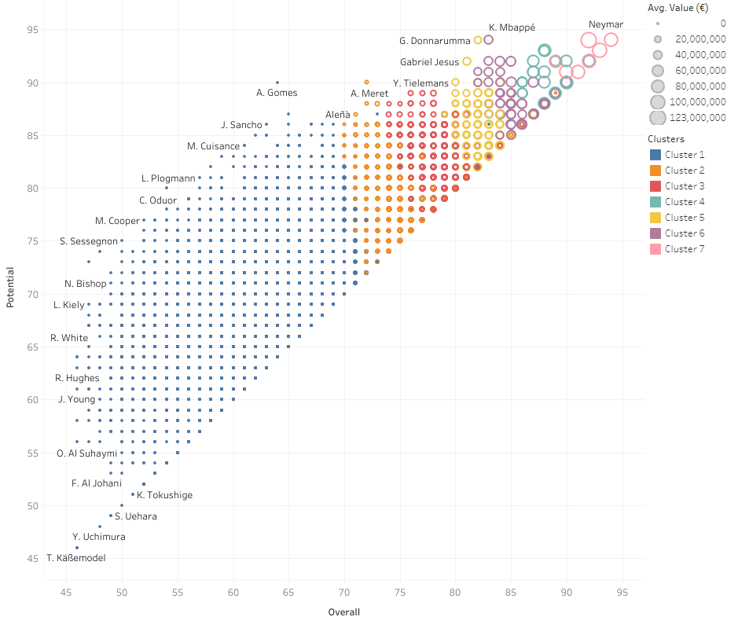

Slide 11
Heatmap
Heatmap of Correlation of Strength and overall rating of the clubs, secondly correlation of the Potential and Overall ratings of the club

Slide 12
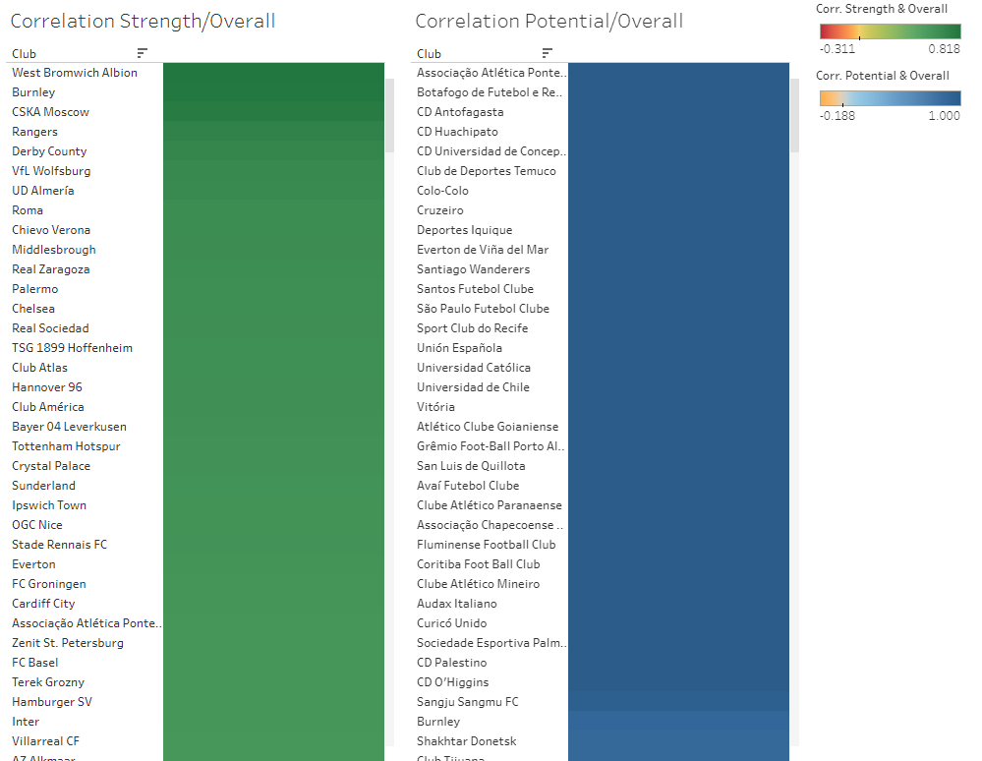

Slide 13
Top 10 Correlation
Above mentioned Heatmap but slightly tuned, it contains data of top 10 clubs by value

Slide 14
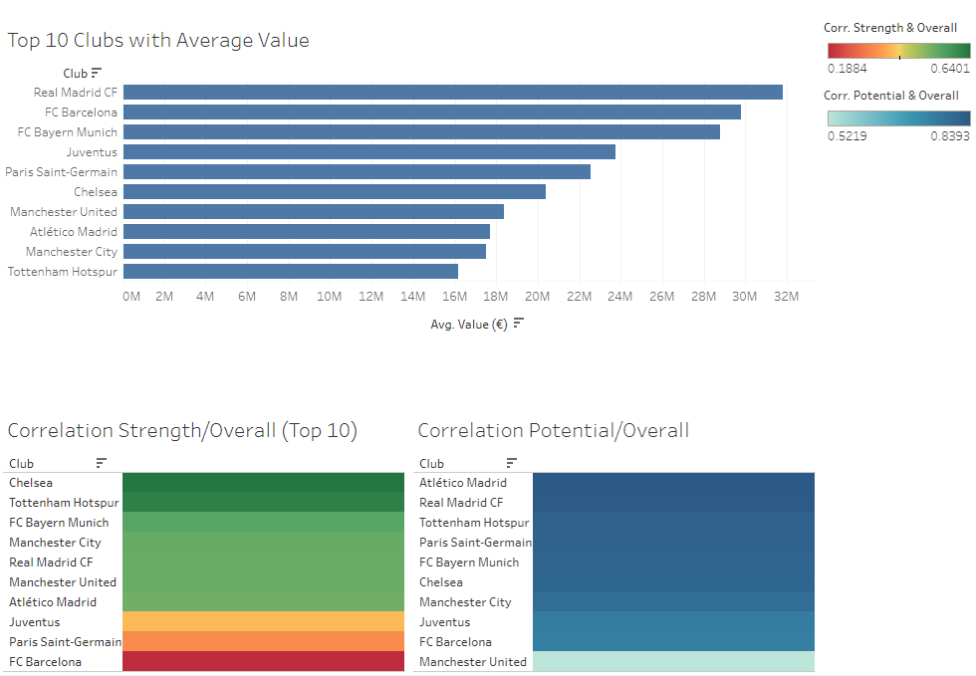

Slide 15
Age Heatmap
Player position and rating, interestingly ST, CM, CDM, CB and GK are best preference of positions by top rated players. Fascinatingly, they all lie in the middle.

Slide 16
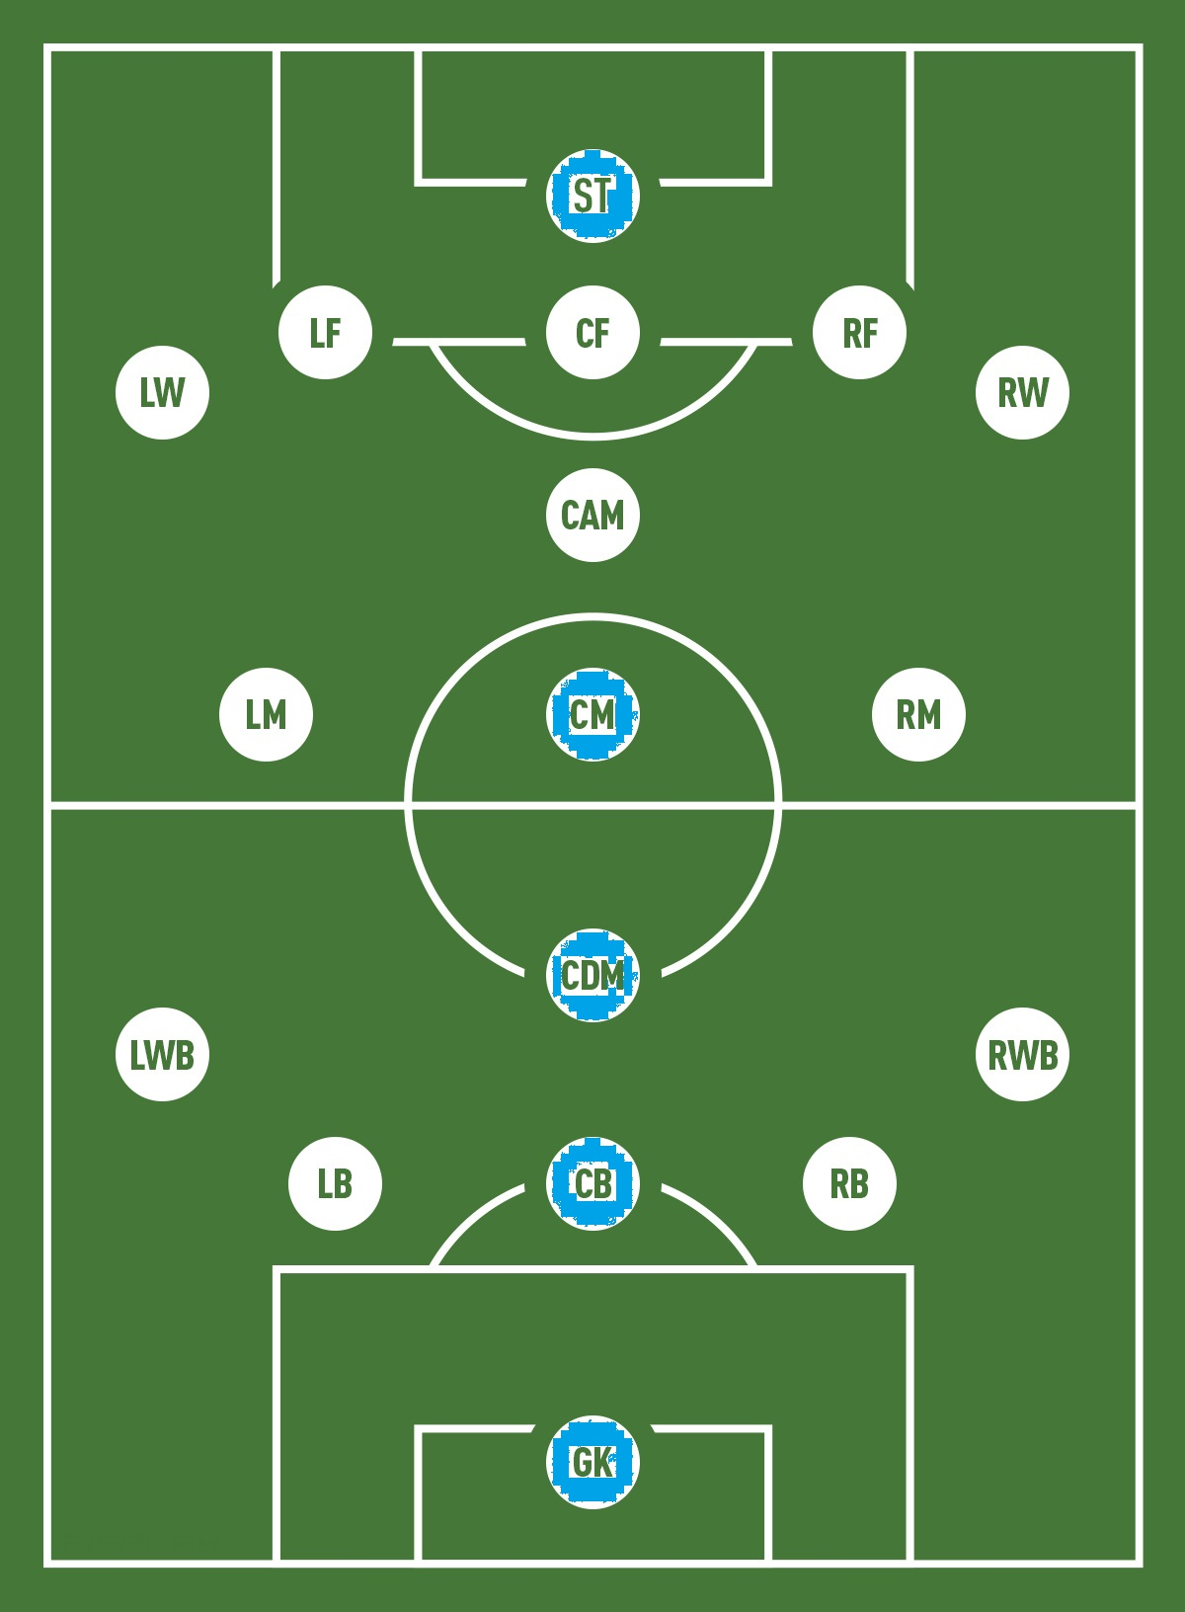
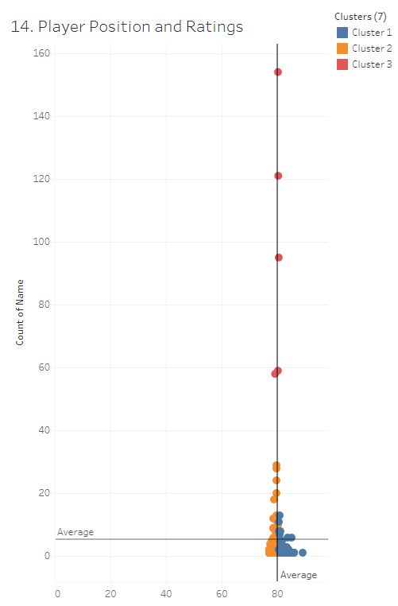

Slide 17
Presentation Ends here

